Slide 1
Component 2: Style Frame
Ross McCallum

Slide 2
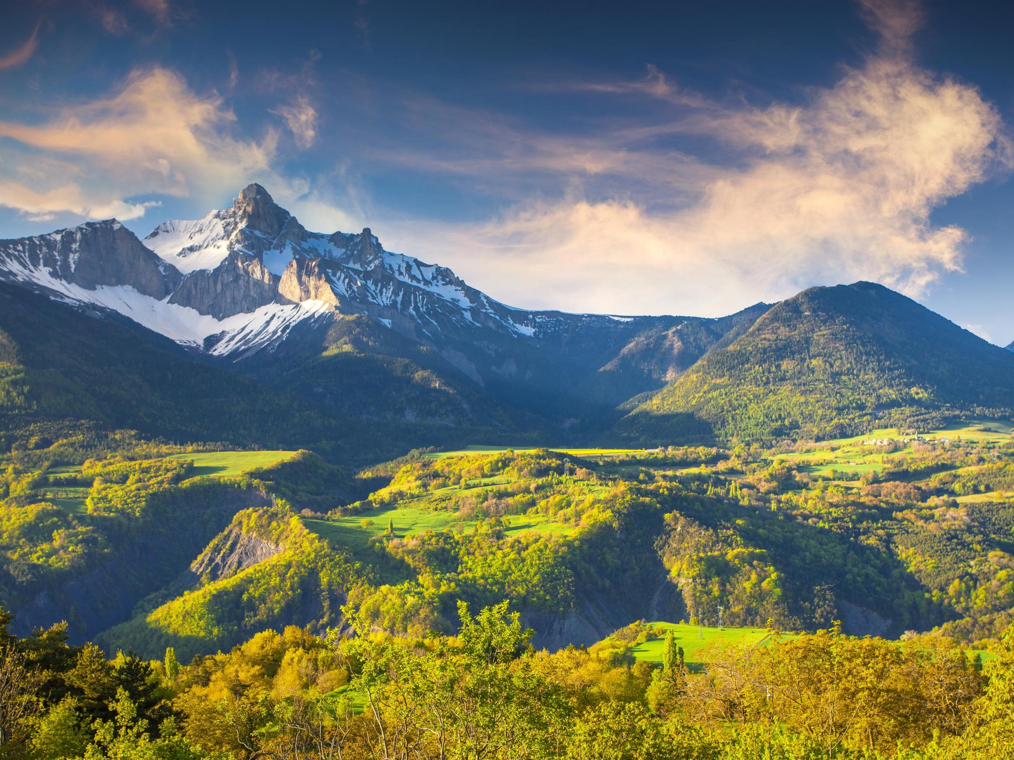
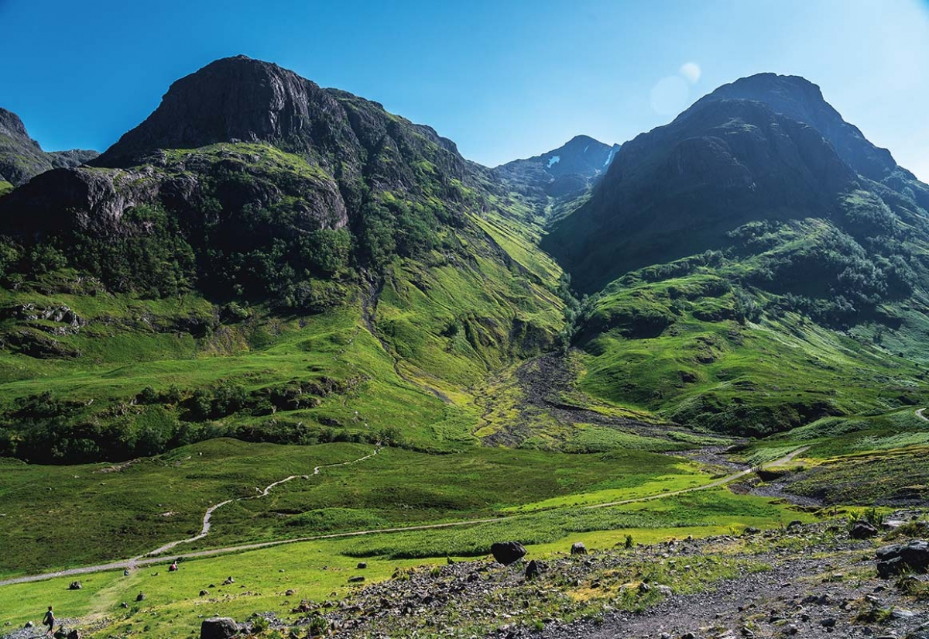
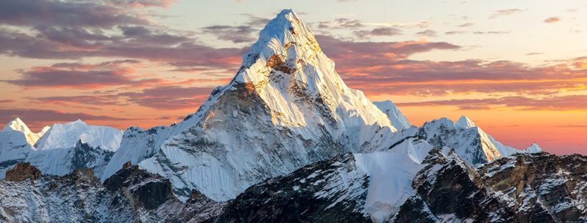
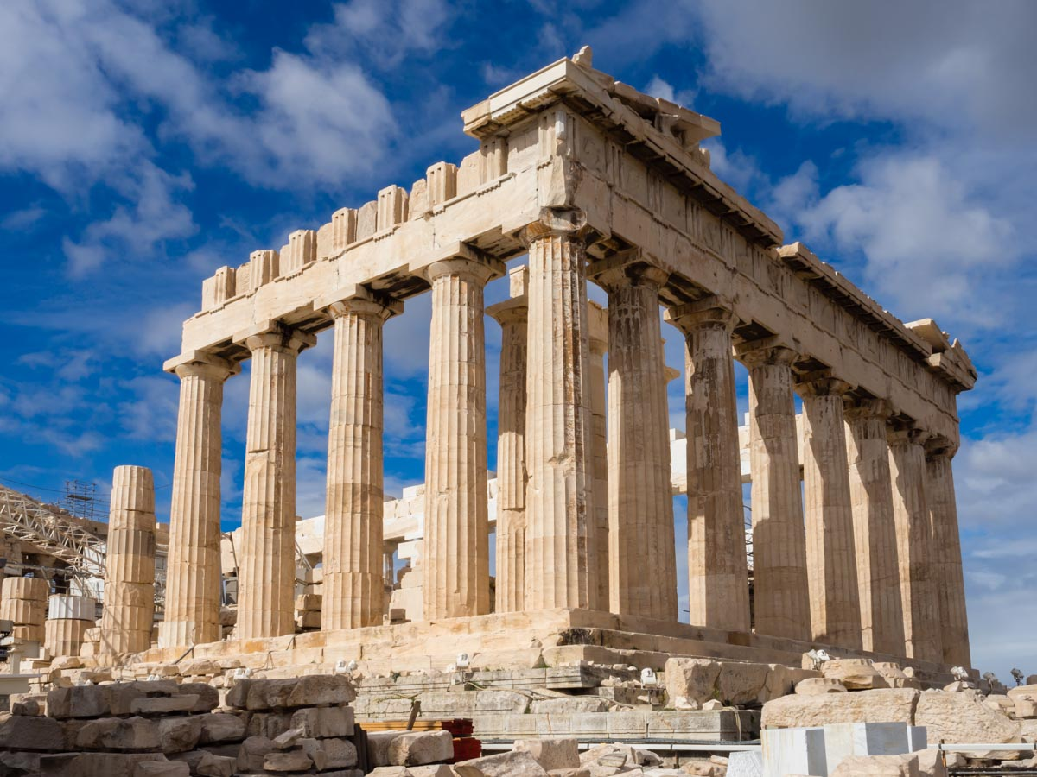
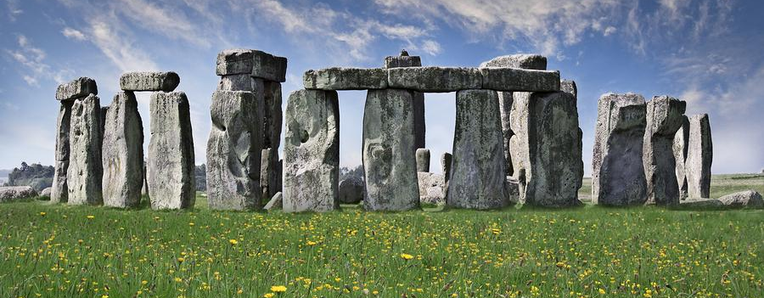
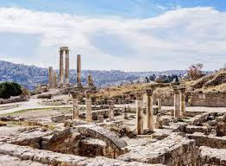
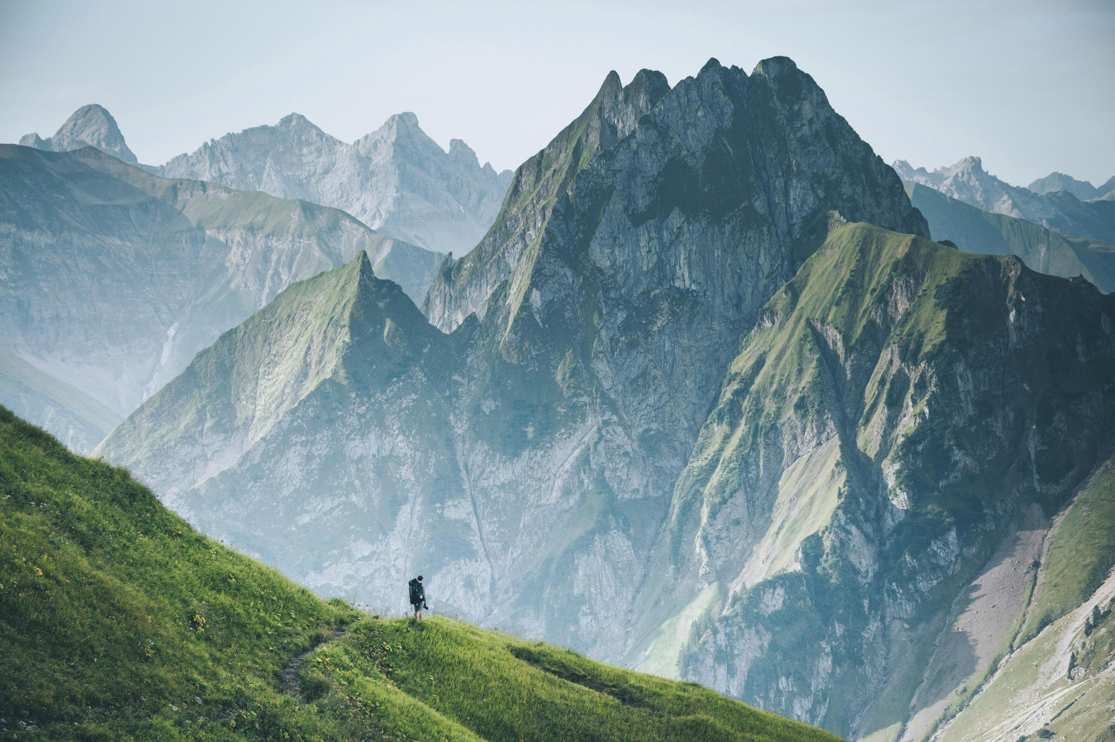
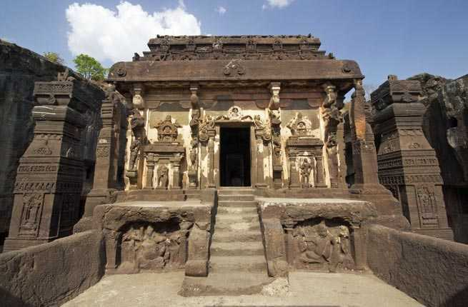
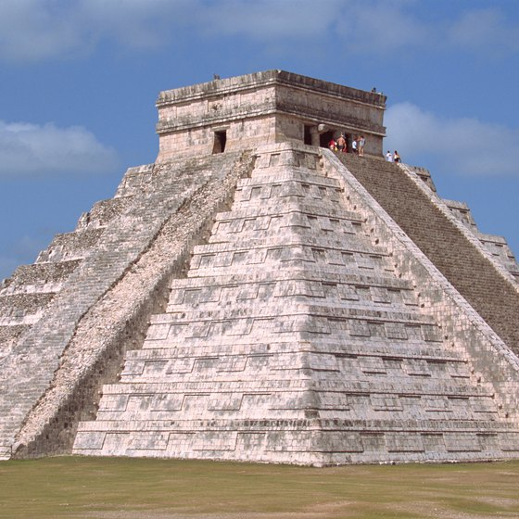
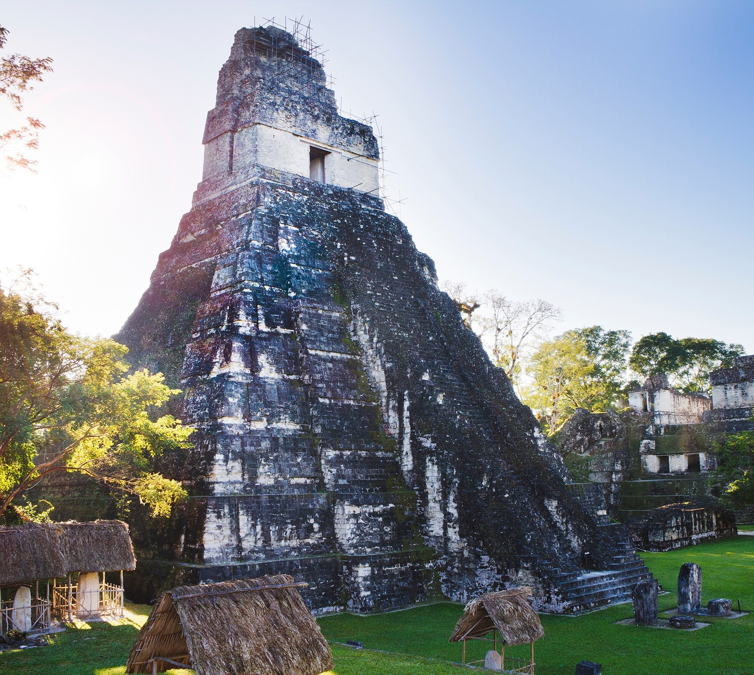
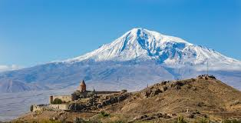
Research
For my final set extension I wanted to create a landscape on a alien planet with mountains in the background and some ruins in the foreground. So firstly I started to look at mountains and ruins that I could but into the style frame.

Slide 3
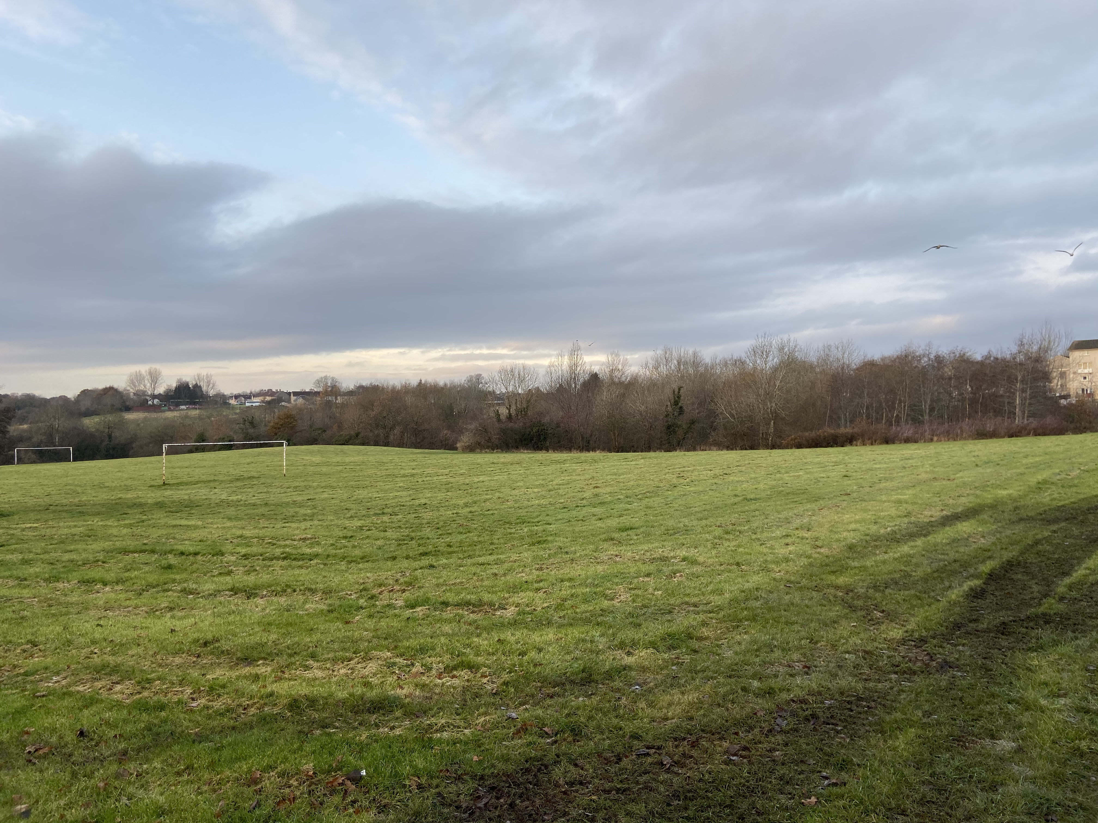
Plate Image
The plate for my set extension is going to be a field as I feel this would be the easiest setting to add in the assets, I want to add in. The video will last for 20 seconds and pan from left to right. However the image below is temporary until I get my actual plate.

Slide 4
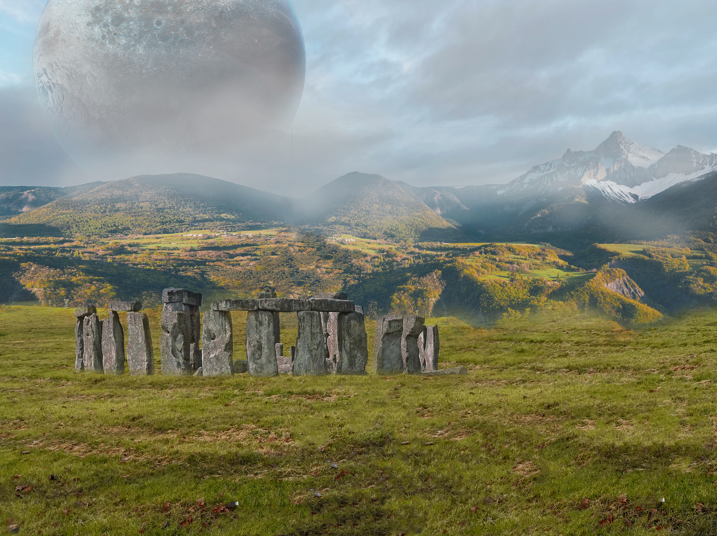
Style Frame

Slide 5
How I’m Creating My Set Extension
To create the Stonehenge in the foreground I am going to create it in Maya and texture it.
The mountains in the background I am going to project image textures over simple shapes so that it creates a 3D look.
I also decided to add a planet into the background so it looked more like an alien planet I will create this my projecting a image of a planet over a sphere so it has a curved look.

